Slide 1

ByteBazaar
Sansi Bindika, Benjamin Cottrell, Muhammad Khan
Notes:
Good afternoon,
We’re “7-dog-slide”
I’m Benjamin Cottrell
Sansi Bindika
Muhammad Khan
And this is Byte Bazaar

Slide 2
What and Why?
Identified a market need
There is nowhere which sells all of a coders’ needs in one place! (In this timeline Amazon doesn’t exist)
I want to see how to improve my setup as I improve my technical abilities.
How will we meet the need?
  Single-page application using React & Node
  Client-side storage
  Firebase authentication
  Context API

Slide 3

What and Why?
Concept
  What does our site do?
  What was our motivation?
  What is our user story?

Slide 4

Process
Technologies Used
Github & Netlify integration
Agile Workflow
React / Node
  Context API
Firebase Authentication
Visual Studio Code
  JavaScript
  HTML
  CSS

Slide 5
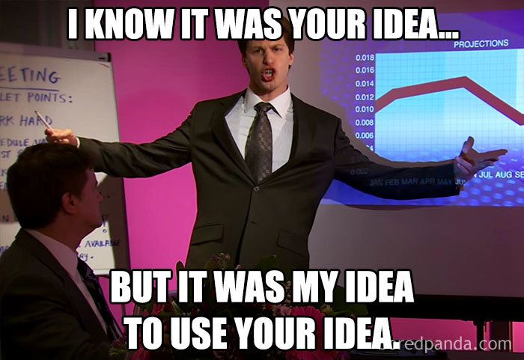
Tasks & Delegation
Tasks & Roles
  Sansi – Context API & Contact Form API
  Benjamin – Firebase, Local Storage & Presentation
  Muhammad – React Framework, Product Filter

Slide 6

Successes
Successes
Discussed comfort levels with individual technologies
Effectively distributed work load
Shared an ambition to achieve
Used tutors and TA’s to overcome obstacles

Slide 7

Challenges
Challenges
Local storage while using React
Login authentication
How to best use Context API to set global states
How to filter the products in a user-friendly manner
Using GitHub branches correctly

Slide 8
Demo

Slide 9
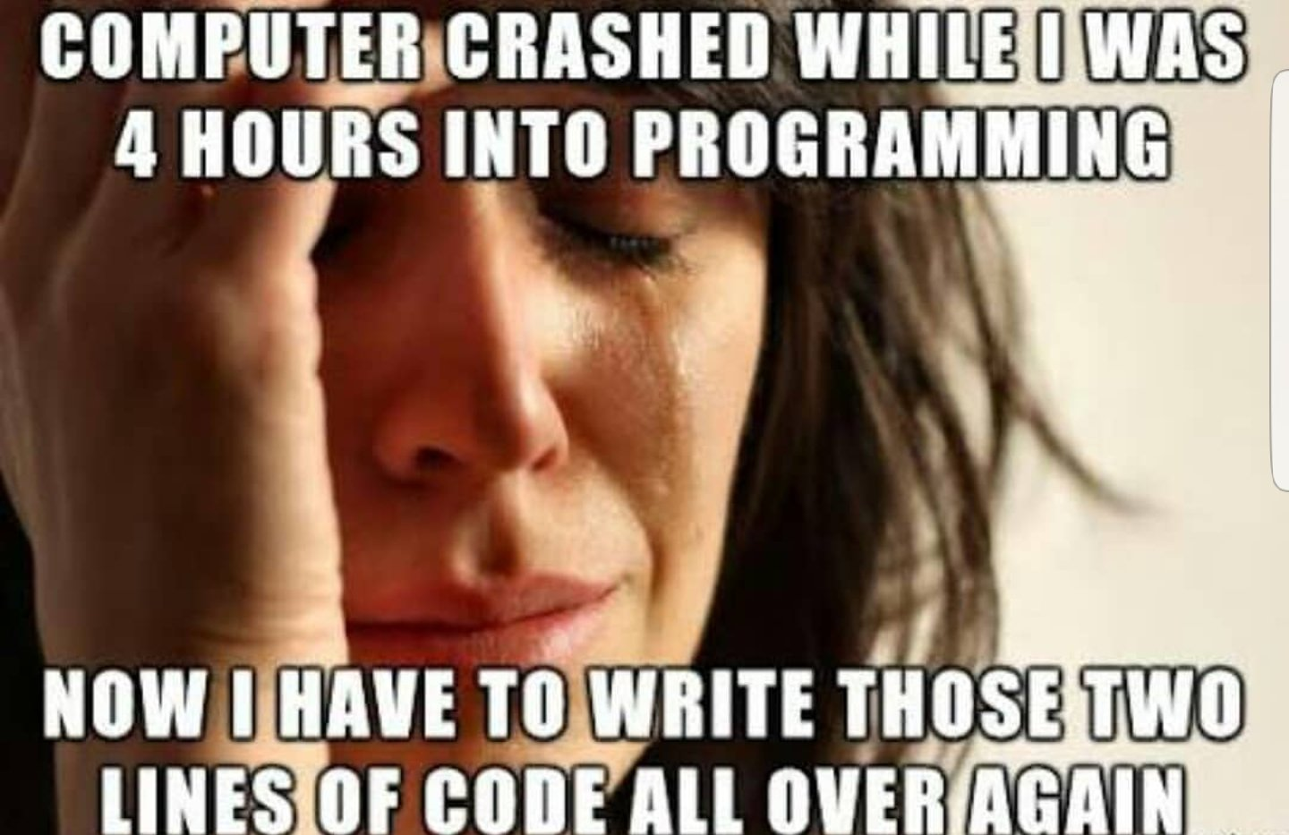
Future Development
Additional products
Product review section
Improved search functionality
Auto-checkout with bank integration (Klarna etc)

Slide 10
Links & Credits
Links
Deployed URL
https://github.com/Maks6831/react-programming-ecommerce
Netlify Hosting
https://bytebazaar.netlify.app/
Credits
ReactToDos
Firebase
A Basic Git Workflow for Small Projects

Slide 11
Any Questions?
Sansi Bindika, Benjamin Cottrell, Muhammad Khan

